Slide 1

Lessons from Quarantine
STUDENT WELLNESS, FACULTY RESILENCE, AND THE FUTURE OF HIGHER EDUCATION
William Kuskin
University of Colorado Boulder
Notes:
My name is William Kuskin, and I am professor and faculty director of Innovation in online learning at the University of Colorado Boulder.
The day is just beginning here on the east coast of North America, but the first day of the 2020 eStars conference is wrapping up. So, good morning and good afternoon!
I am delighted our panelists can join us for this international experience.
I am very delighted our viewing audience is here, and of course this is panel will also be available asynchronously.

Slide 2
Lessons from Quarantine
STUDENT WELLNESS, FACULTY RESILENCE, AND THE FUTURE OF HIGHER EDUCATION
01
Physically Distant
Socially Engaged
William Kuskin
Professor and Faculty Director
University of Colorado Boulder
02
Learning to Work Successfully In Teams, Even in the Pandemic
Gloria Flores
President
Pluralistic Networks
03
The Classroom is Dead!
Long Live the Classroom!
Cory Pavicich
Academic Director
Noodle Partners
04
Student, Faculty, and Institutional Impacts of Pandemic Pedagogy
Christopher Haynes
Director of Learning Experience Design
University of Colorado Boulder
05
The Challenges and Issues of Online Education
Rona Bušljeta Kardum
Assistant Professor, Faculty of Croatian Studies
University of Zagreb
Notes:
1. It gives me great pleasure to introduce the panelists, each of whom I have worked with in a variety of contexts.
1. Each panelist, including myself, has prepared a short presentation.
2. I would to move through all four, and then have a discussion
3. I will introduce the panelists before their paper.

Slide 3
Physically Distant; Socially Engaged
William Kuskin
University of Colorado Boulder

Slide 4
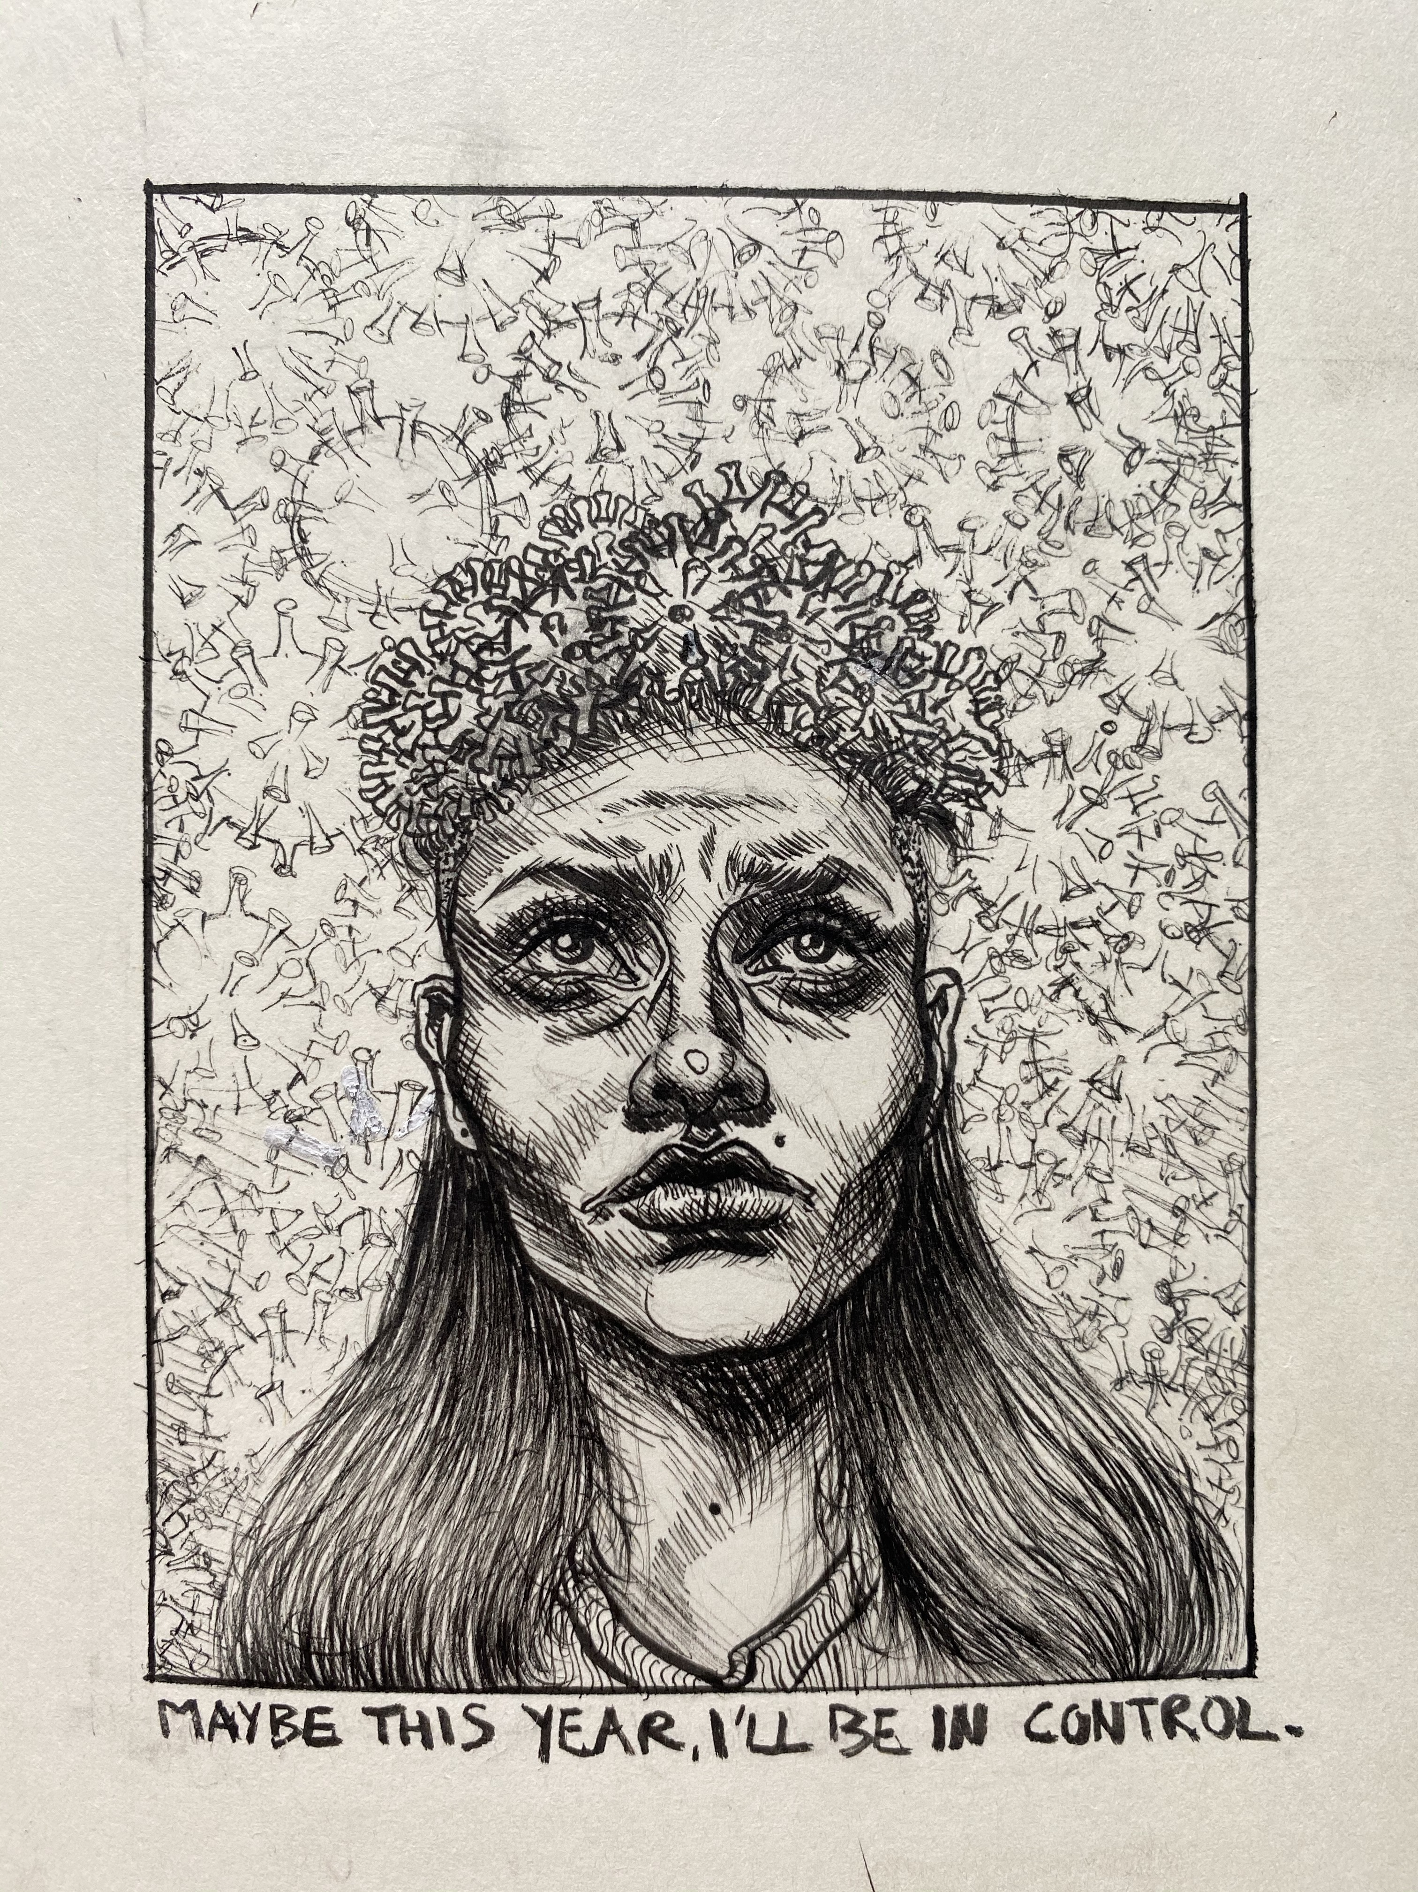
Hannah
“Control”
Notes:
The first piece I want to show is Hannah’s first cartoon
This is an amazing piece
It speaks of the desire for control—over one’s life, over one’s work, over the trajectory of one’s intellectual growth
“Maybe” shadows that there is a history here; it reminds us that although the figure is sophisticated, and though she is beautiful, strong, and hopeful, Hannah is a student grappling with the challenge of learning how to learn
The background is a rain of COVID-19 Viruses; indeed they crown her in this time of crisis
And if you look closely, the little bit of whiteout reminds us of the difficulty of human labor; it marks the difficulty of control in the cartoon itself.
3. I read this as a little poem about the impossibility of control, and the beauty in imperfection.

Slide 5
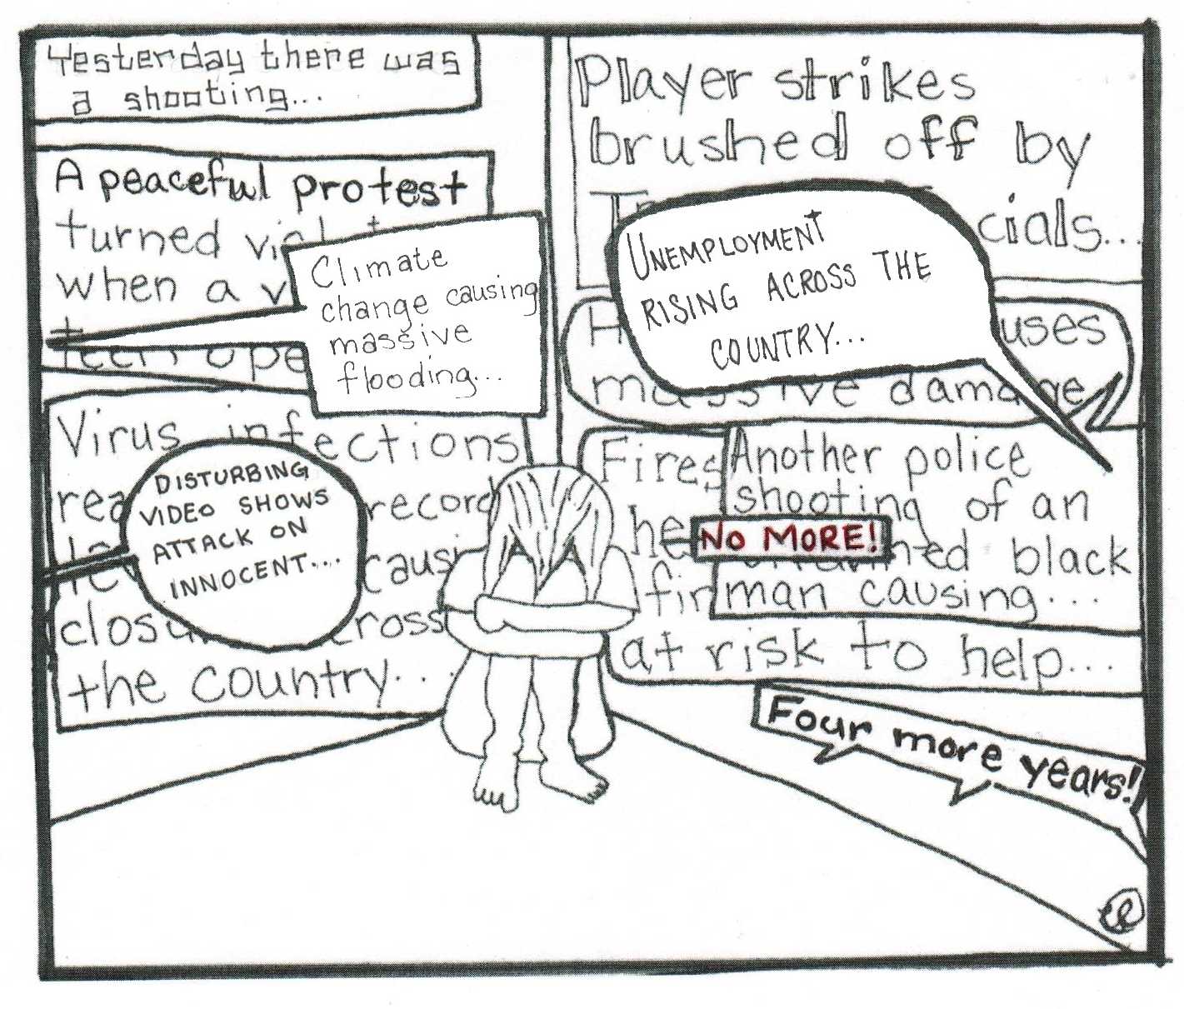
Liz
“No Moore”
Notes:
This is Liz’s second cartoon, and it cartoon reminds me that school is only one part of our students’ experience.
It is about school
It is about politics
It is about being overwhelmed
But it also asks a fundamental question: Who is she saying NO More! too?
Some faceless media?
To one political leader?
To herself
This is a cartoon of brute despair, f frustration and resignation
1. The Cartoon reminds us that the crisis is multidirectional
2. Not only is the crisis multidimensional, it is ubiquitous
3. It reminds us, too, that we go to school to gain strength, to learn some sense of discipline, of critical thinking.

Slide 6
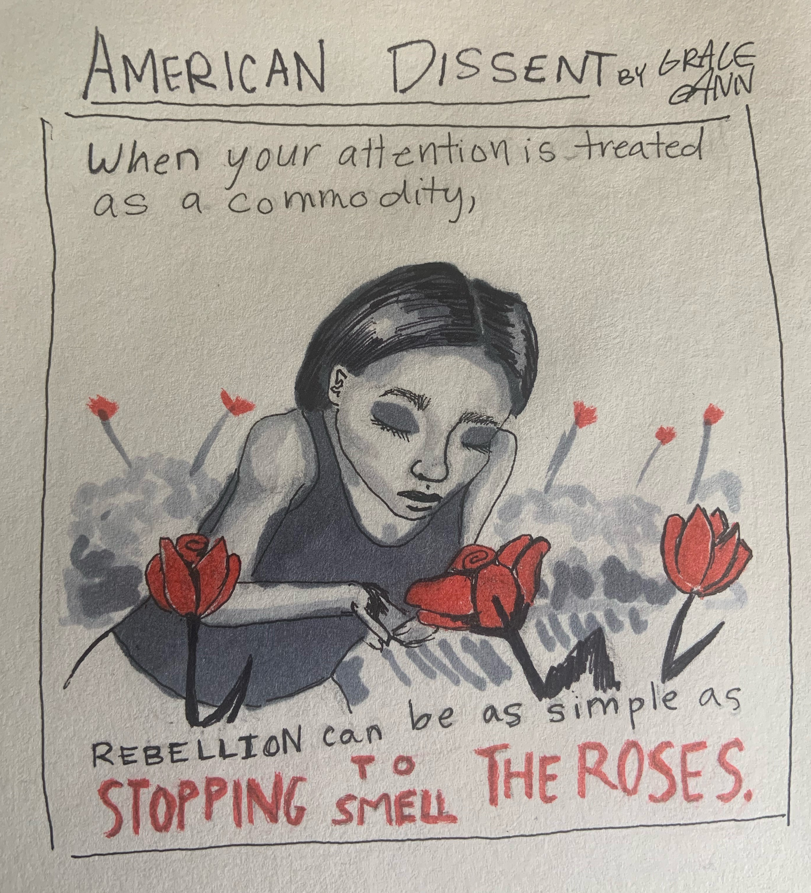
Grace
“American Dissent”
Notes:
This is Grace’s second Cartoon, a response to the prompt to draw a political cartoon about dissent
I read this this Cartoon as poem on honest engagement as a complete experience
For my own purposes I might rephrase it; learning can be as simple as stopping to smell the roses.

Slide 7
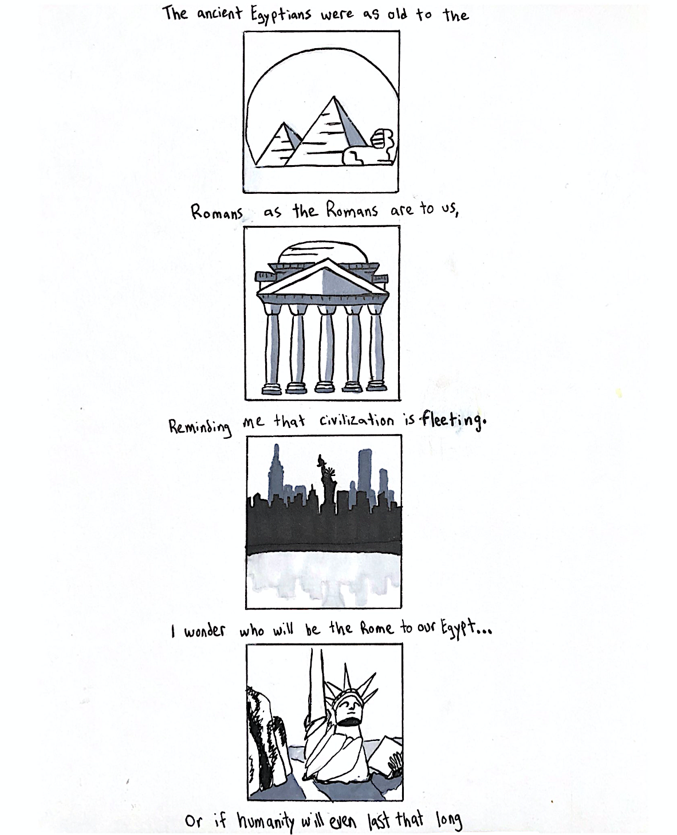
Jake
“History is Long”
Notes:
1. I want to end with one final comic strip, by Jake entitled “History is Long.”
2. What is so smart about Jake’s cartoon is his recognition that we are in a historical moment
3. A lot seems to hang in the balance
4. Now clearly, Hannah, Liz, Grace, and Jake are smart and talented.
They had never taken a comics course before, and they produced these works within the first month of the course.
I did not teach them to think
They challenged themselves to create content, and take within an educational forum.

Slide 8
Conclusions
The Temptations of Control
Given the radical instability created by the pandemic, we are tempted to provide better education by teaching more: by replicating a successful campus or online course in the remote setting.
A Threefold Challenge for Students
The pandemic has created a threefold challenge for our students: it has intensified their screen time; undercut their social support network; and, like all of us, barraged them with negative information.
Our students are not simply challenged to adjust to a new learning environment; they are facing a multidirectional crisis.
Engagement Produces Content
I suggest a positive feedback loop: by making space for engagement as fundamental to learning we can engage our students to create content.
The benefits of such a feedback loop are that the students challenge themselves to be resilient and thoughtful, while covering the core concepts of the class, in a time of crisis.
* Сноски / ссылки и т.п.

Slide 9

Thank you!

